Slide 1
Expense Tracker – A Personal Finance Management Tool
Python-based final Project
NAME : SYED OWAIS QUADRI
COURSE : CSS- 225
DATE: 09/02/2025

Slide 2
Introduction
Managing personal expenses is challenging without a proper tool.
People often lose track of daily spending.
Goal: Create a simple Python-based expense tracker that is user-friendly and visual.

Slide 3
Project Transparency & Code Organization
finance_tracker_fixed/
│── main.py - Entry point (handles user input, flow control)
│── input_handler.py - Handles CSV file reading/writing
│── tracker.py - Core logic: add expenses, calculate totals, summaries
| ── charts.py` - matplotlib visualizations
│──expenses.csv – sample data
Why different files?
main.py → keeps the project modular & clean
input_handler.py → separates file I/O from logic
tracker.py → encapsulates calculation & business logic
charts.py → only focuses on visualization
This modular design improves transparency, reusability, and debugging

Slide 4
Project Repository
GitHub Link:
Code is modularized into 4 files

Slide 5
LinkedIn Post
(Screenshot of your LinkedIn post where you share:)
“Excited to share my Python-based Expense Tracker project! 🚀
It helps track daily expenses from CSV/manual input and generates charts for better insights.
Built with Python 3.9, Matplotlib, CSV handling, and modular file design.”

Slide 6
Project Architecture
1) File: main.py
Role:
Entry point of the program.
Handles user interaction (choosing CSV/manual input).
Calls the tracker for calculations.
Calls chart functions for visualization.
2) File: tracker.py
Role:
Core finance tracking logic.
Calculates total income, expenses, remaining balance.
Acts as the “brain” of the application.
3) File: charts.py
Role:
Handles data visualization (bar charts, pie charts).
Uses matplotlib to make results easy to understand.
4) File: data_handler.py (or equivalent in your project)
Role:
Loads expense data from CSV files.
Prepares structured data (income & expenses lists).
Ensures project can work with both manual input and file input.

Slide 7
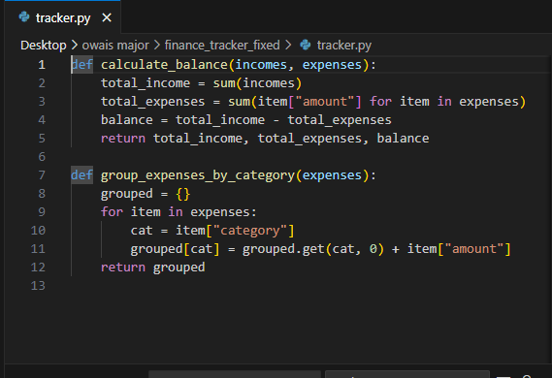
Code Demo

Slide 8
Objectives
Record incomes and expenses
Support two input modes:
CSV file input
Manual entry
Summarize total income, expenses, and balance
Generate visual report (bar chart)

Slide 9
Tools & Technologies
Language: Python
Version: 3.9
Libraries Used:
matplotlib – for charts
csv – for file handling
os – for file path operations
IDE / Execution: Command Prompt with Virtual Environment (venv)

Slide 10
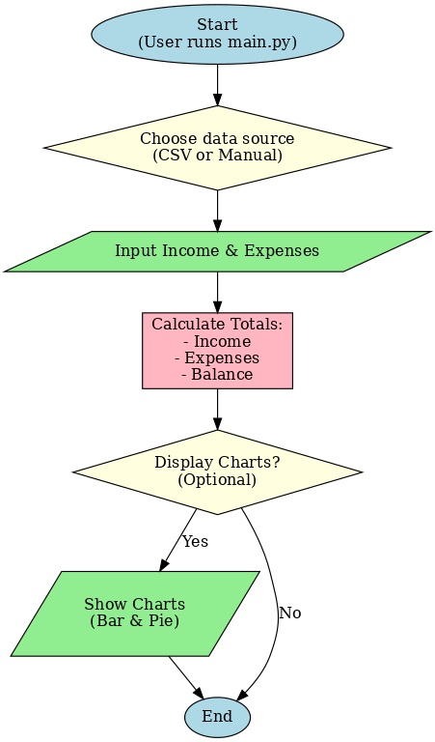
System Workflow
User runs main.py
Chooses data source (CSV or manual)
Inputs income & expenses
Program calculates:
Total income
Total expenses
Remaining balance
Optionally displays charts

Slide 11
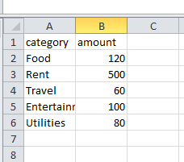
Sample CSV Input

Slide 12

Execution Demo (Screenshots)
Fig 1: code is executed through terminal by entering command “ main.py”

Slide 13

Execution Demo (Screenshots)
Fig 2 : by opting for “csv” sample data can be given and by opting for “manual” customized input data can be give.

Slide 14

Execution Demo (Screenshots)
Fig 3: here we entered “csv” hence ouput will be generated based on sample data .

Slide 15
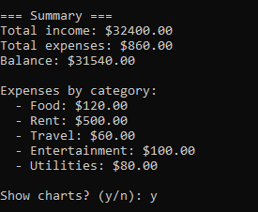
Execution Demo (Screenshots)
Fig 4 :
here output generated by our code clearly shows Details regarding total income, total expenses and balance amount left.
It also describes category for expenses.

Slide 16
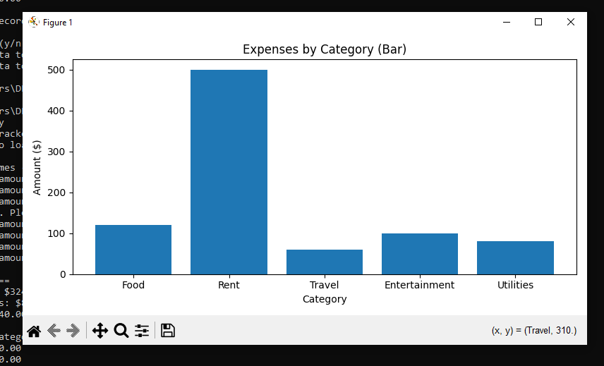
Execution Demo (Screenshots)
Fig 5 :
Based on out output values bar graph is generated, where x- axis represents the “ expenses by category” and y- axis represents “ amount in $”.

Slide 17
Features
Lightweight and easy to run
Flexible input (file/manual)
Visual reports for better analysis
Portable (can run anywhere with Python)

Slide 18
Limitations
Currently console-based (no GUI)
No database support (data is not stored permanently across runs)
Limited to single-user

Slide 19
Future Enhancements
Add GUI interface .
Store data in SQLite or MySQL database
Provide monthly/weekly reports
Add export to PDF/Excel
Build a mobile app version

Slide 20
Conclusion
Successfully built a Python Expense Tracker
Helps manage personal finances efficiently
Demonstrates use of Python libraries & file handling
Future scope: expand to a full-fledged finance management tool

Slide 21
Thank you ..!

